Slide 1


PLEASE….!!☺

Slide 2

WAKE UP…!!

Slide 3
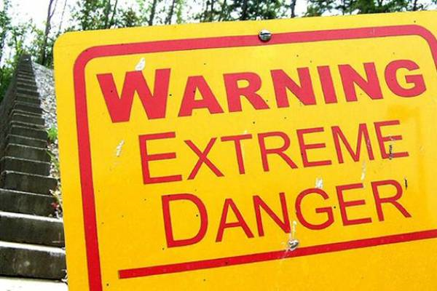

Slide 4

We want to save this smile..!!

Slide 5
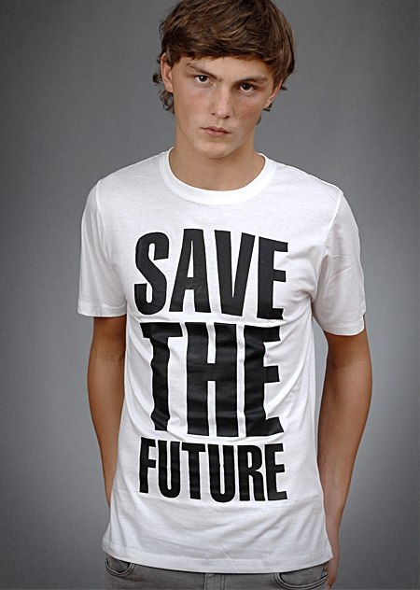

Slide 6
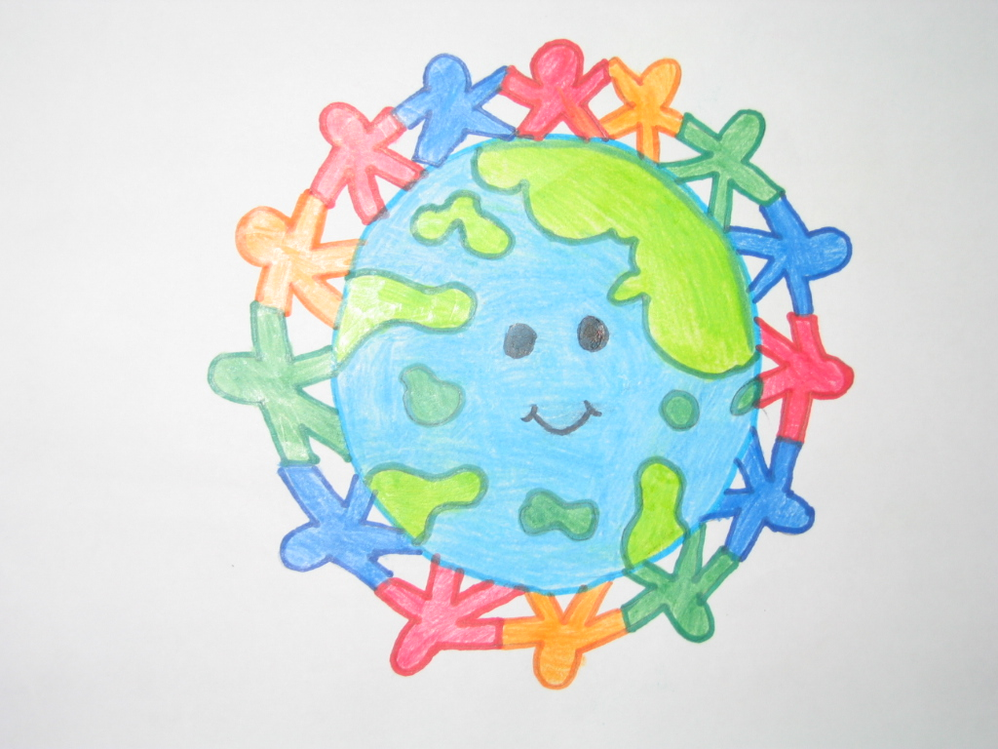
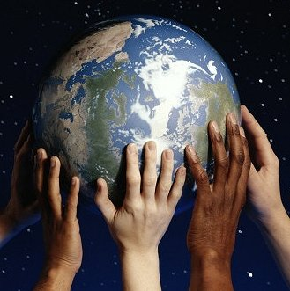

Slide 7


Slide 8
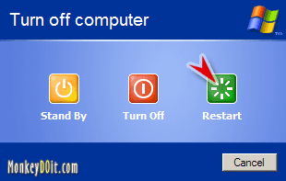

Slide 9
Do you know this problem..??

Slide 10
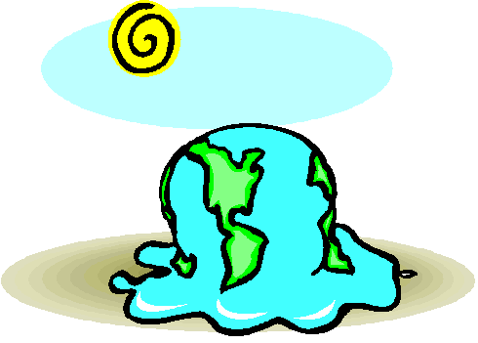
it’s all about…..

Slide 11
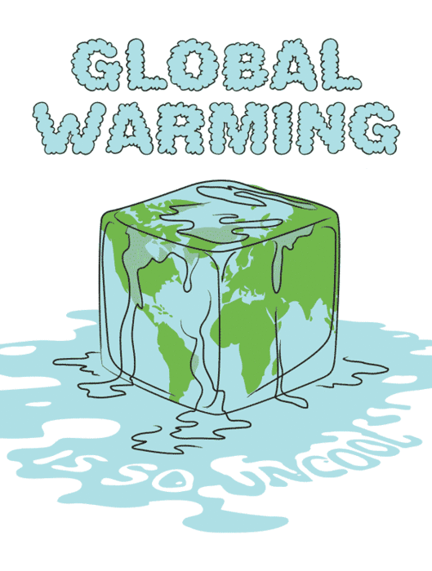
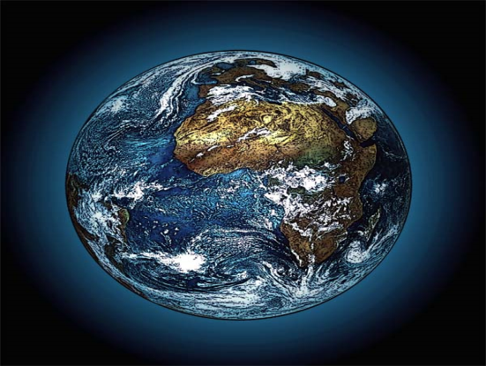
Global warming…!!!!

Slide 12
What is global warming..??
-An increase in the average temperature of the earth's atmosphere

Slide 13
Greenhouse gases..:
1-Carbon dioxide
2-Methane
3-Nitrous oxide

Slide 14
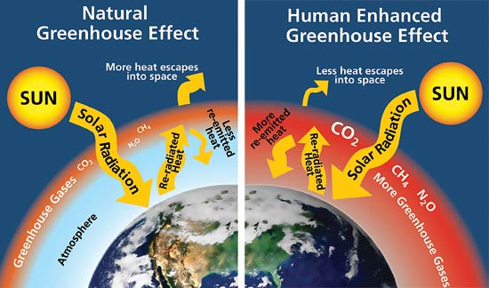

Slide 15
Causes…!!

Slide 16
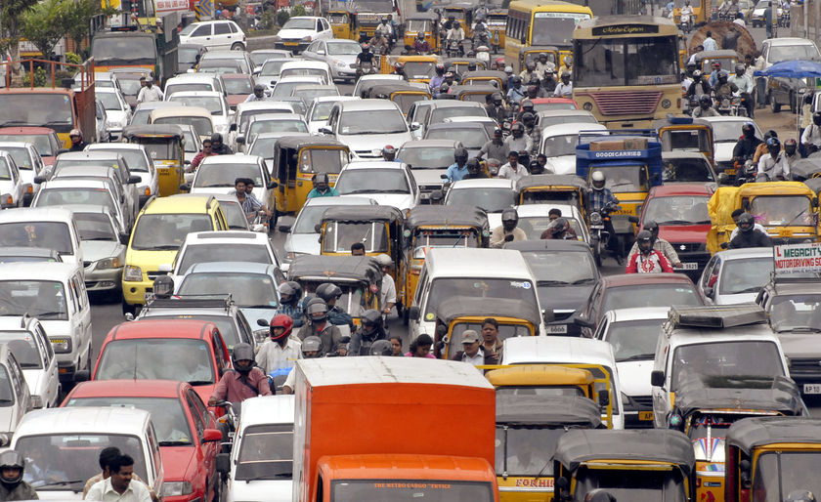

Slide 17
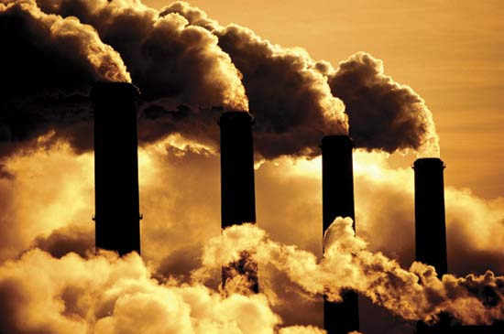

Slide 18

Fossil fuels:
(Oil,Coal,natural gas)

Slide 19
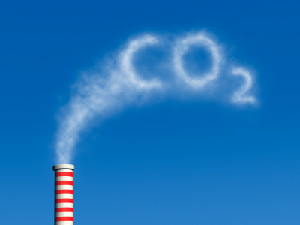


Slide 20
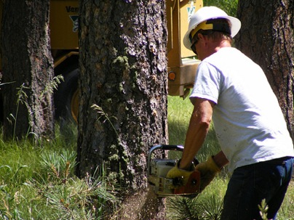
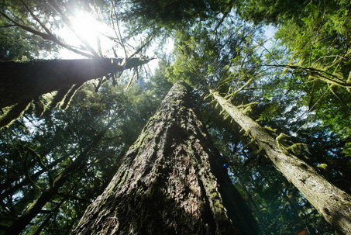

Slide 21
Results..:

Slide 22
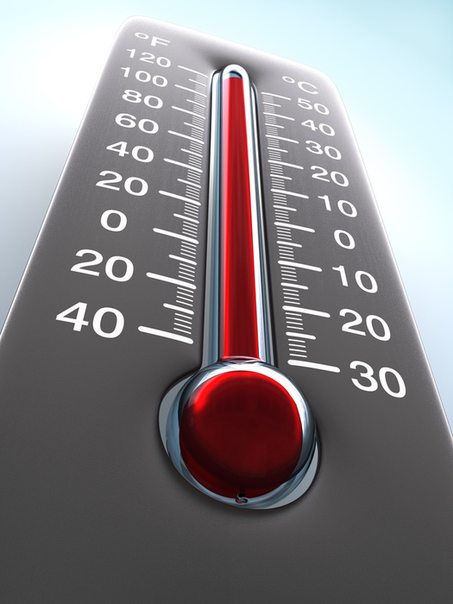
1-increasing temperatures

Slide 23
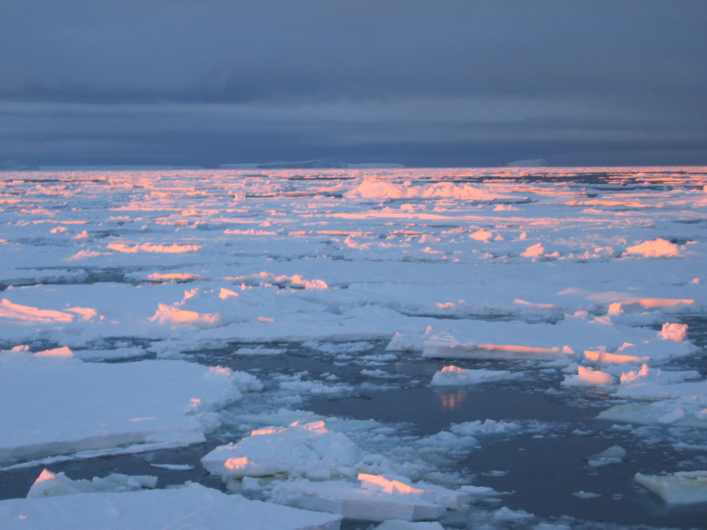
2-Ice melting..!!

Slide 24
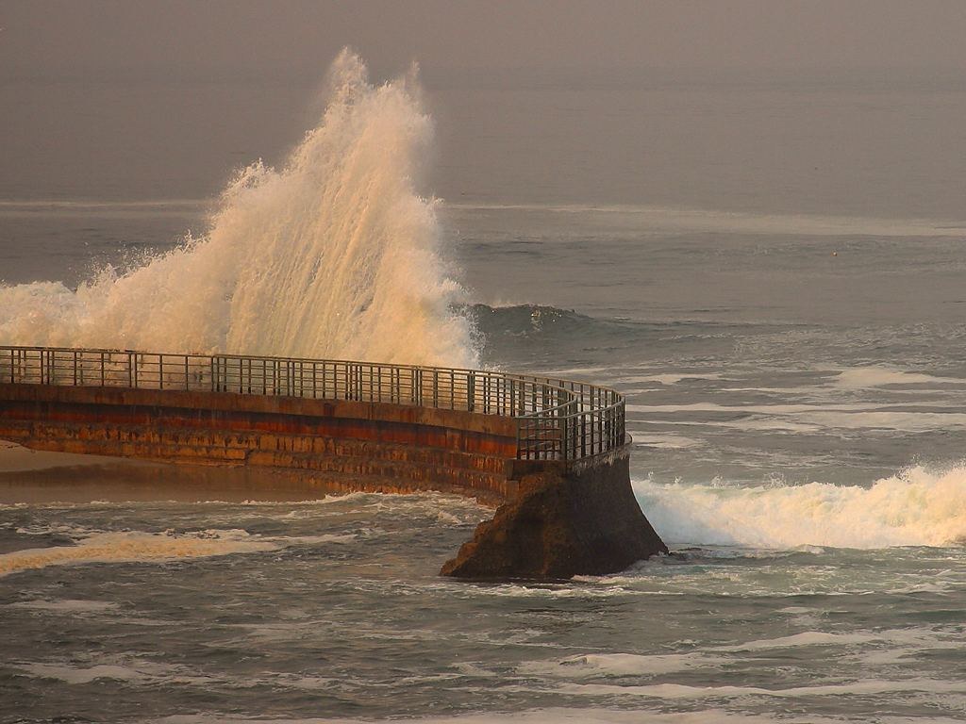
3- increasing sea levels

Slide 25
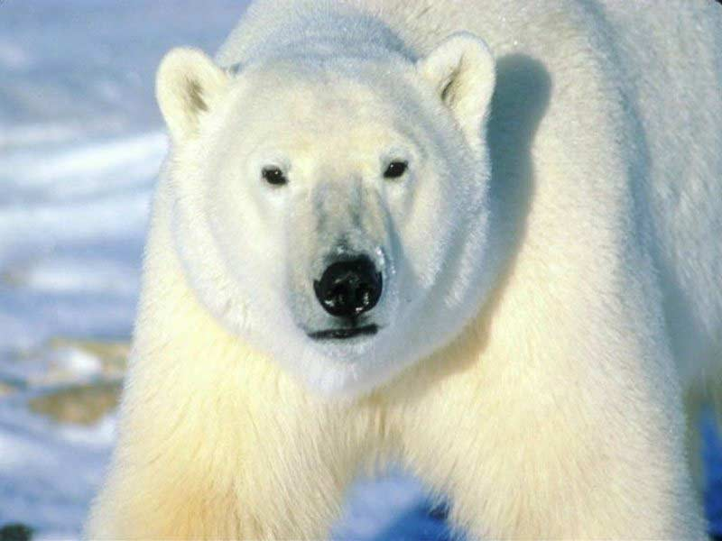
4-disappearing animals

Slide 26
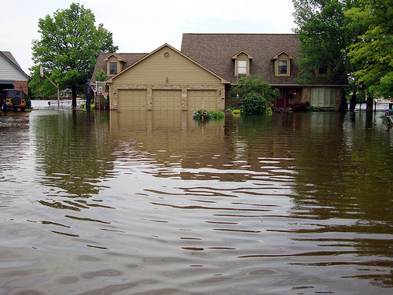
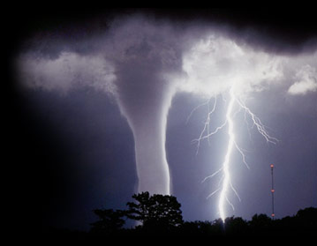
5-floods and tornadoes

Slide 27
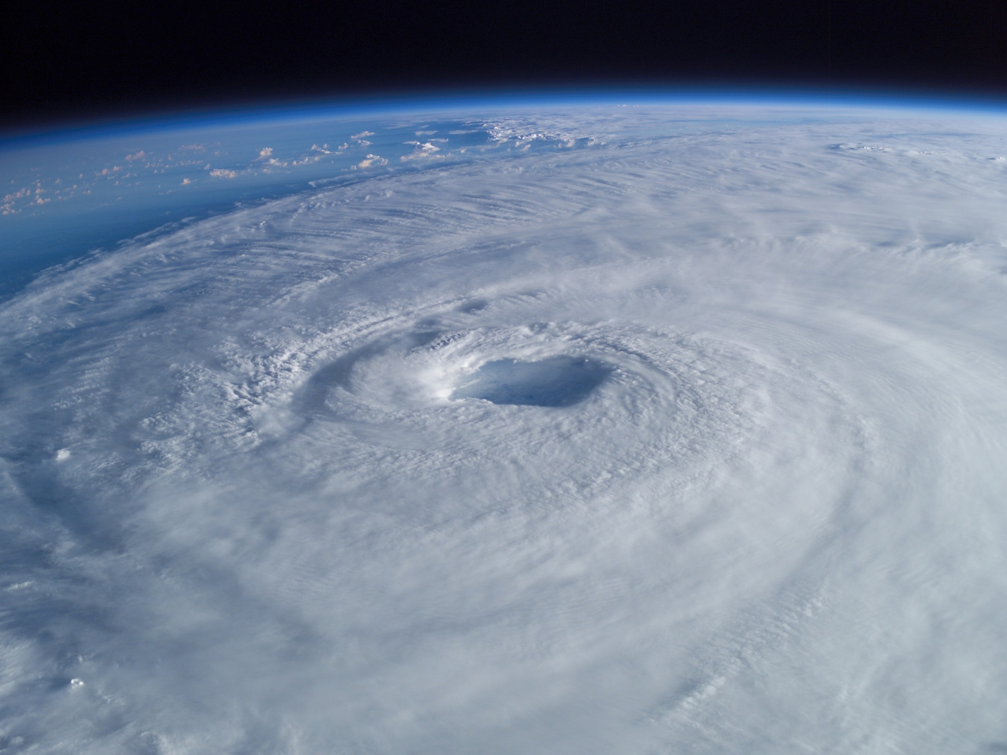
6-Hurricanes

Slide 28
-How can we see these changes??

Slide 29
Floods

Slide 30
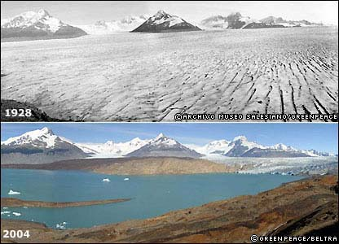

Slide 31
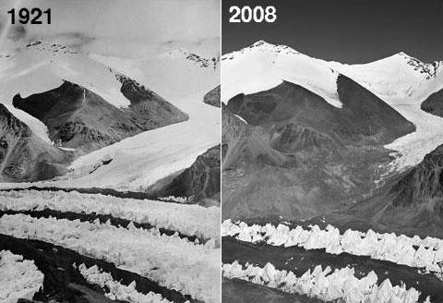

Slide 32
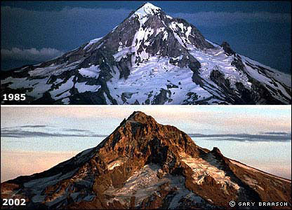

Slide 33
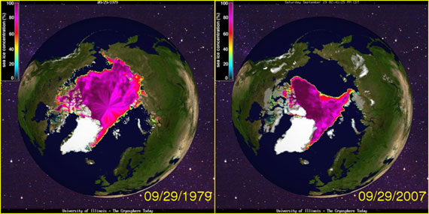

Slide 34


Slide 35



Power saving bulbs..:

Slide 36
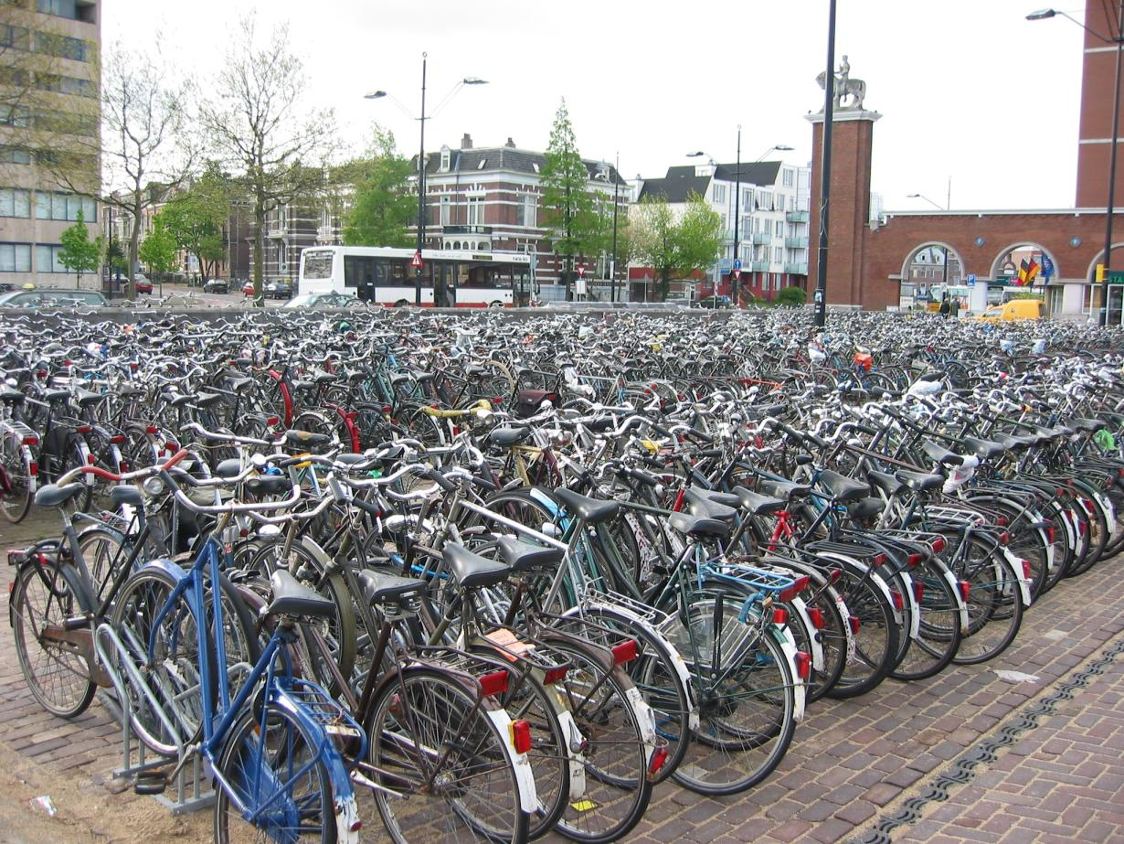
Bicycles..:

Slide 37
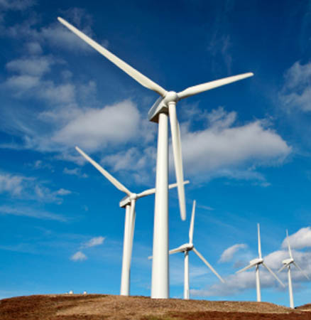
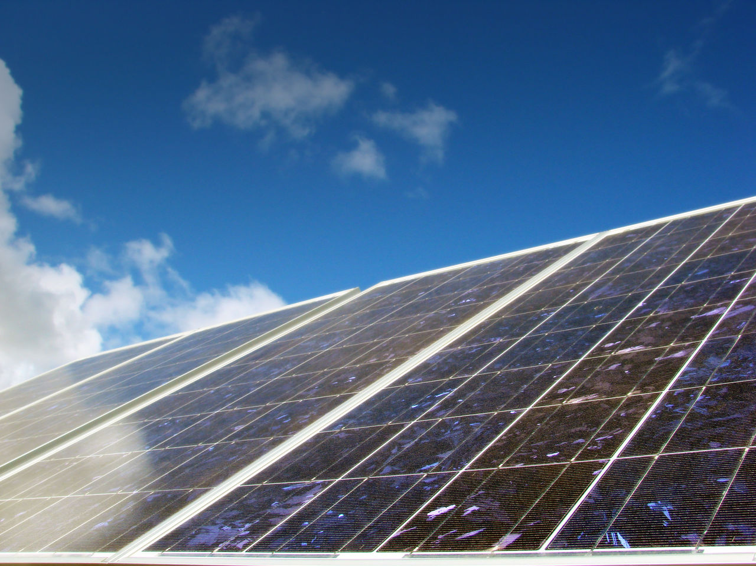
Clean energy resources..:

Slide 38

Worldwide achievements .!!

Slide 39

UNFCCC
The United Nations Framework Convention on Climate Change

Slide 40
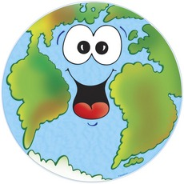
COP..!!

Slide 41
1995
2010..!!
And also 2011 and 2012..!!

Slide 42


Slide 43
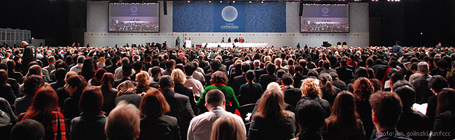
-194 countries signed it..!!

Slide 44

- 1997 cop (3)KYOTO PROTOCOL !

Slide 45
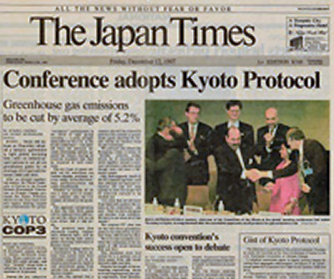

Slide 46
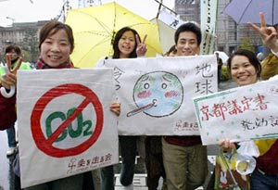

Slide 47
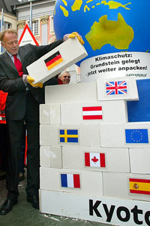
What is Kyoto Protocol?
-The Kyoto Protocol is an international agreement setting targets for industrialized countries to cut their greenhouse gas emissions.

Slide 48
-What are the targets?

Slide 49
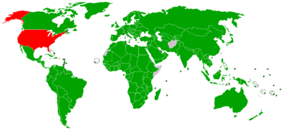

Slide 50
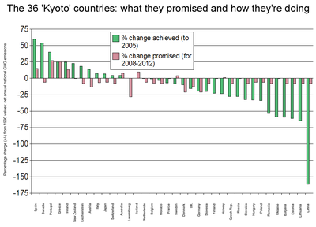

Slide 51


Slide 52
From 1995 till now.. What else…!!!

Slide 53

BEGIN WITH YOURSELF…!!

Slide 54


Slide 55

-This is our home… help saving it..!!☺

Slide 56



Slide 57

BY:
1-Karim Magdy
Contact:
Kimotadros95@hotmail.com
2-Ahmed Abdel Maksoud
Contact:
Ahmed_m95@hotmail.com

Slide 58
References:
www.bbc.com
www.wikipedia.com
www.google.com
www.stopglobalwarming.com
www.nationalgeographic.com

